Slide 1
Hobby Web Application
Amandeep Bassi

Slide 2
Introduction
Agile - Broke the project into small tasks, thought about what could go wrong
Jira - Keep track of user stories and set targets
Git / Github - Keep track of the development
MySQL - Data driven application, database hosted on a local instance
Spring Boot - Java framework to build backend API
HTML / JS - Build web frontend
CSS / Bootstrap - Apply styles and modal functionality
JUnit / Mockito - Testing the application
Selenium - Web browser automation for frontend testing
Swagger - Visualise and describe API structure

Slide 3
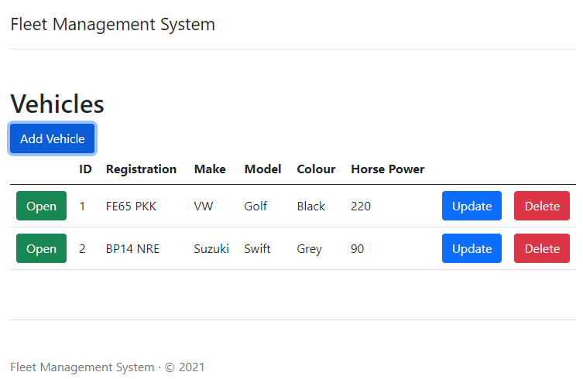
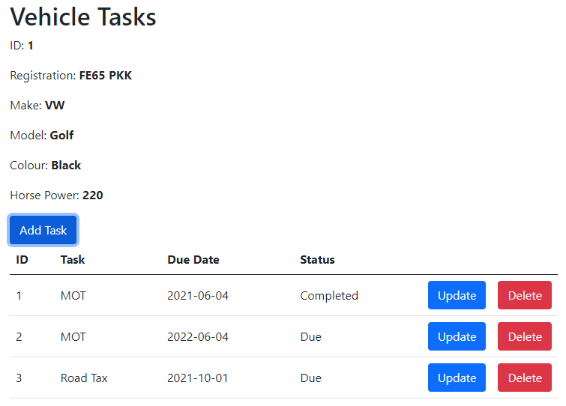
Concept
A web application which helps users keep track of vehicle maintenance.
Many vehicles can be stored in to the system.
Each vehicle can have its own record of tasks e.g.(Insurance, Road tax)
Each task has a due date and status

Slide 4
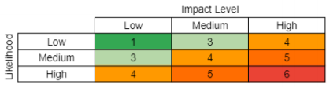
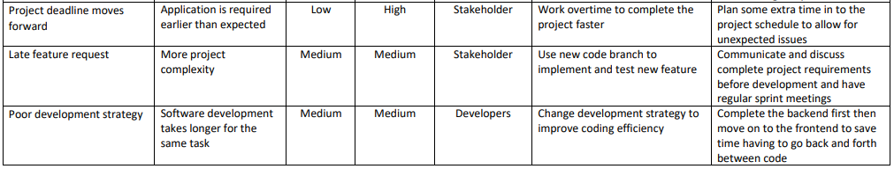
Risk assessment

Slide 5
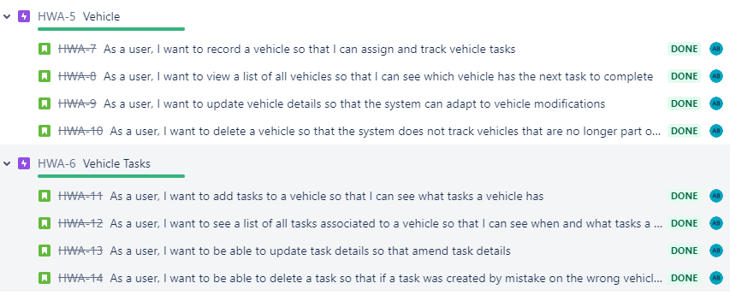
Sprint Plan

Slide 6
Consultant Journey

Slide 7
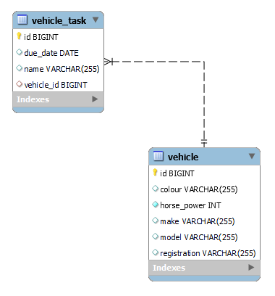
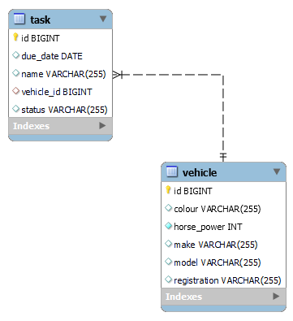
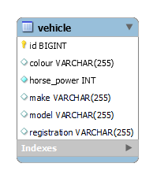
MySQL
Version 3
Version 2
Version 1

Slide 8
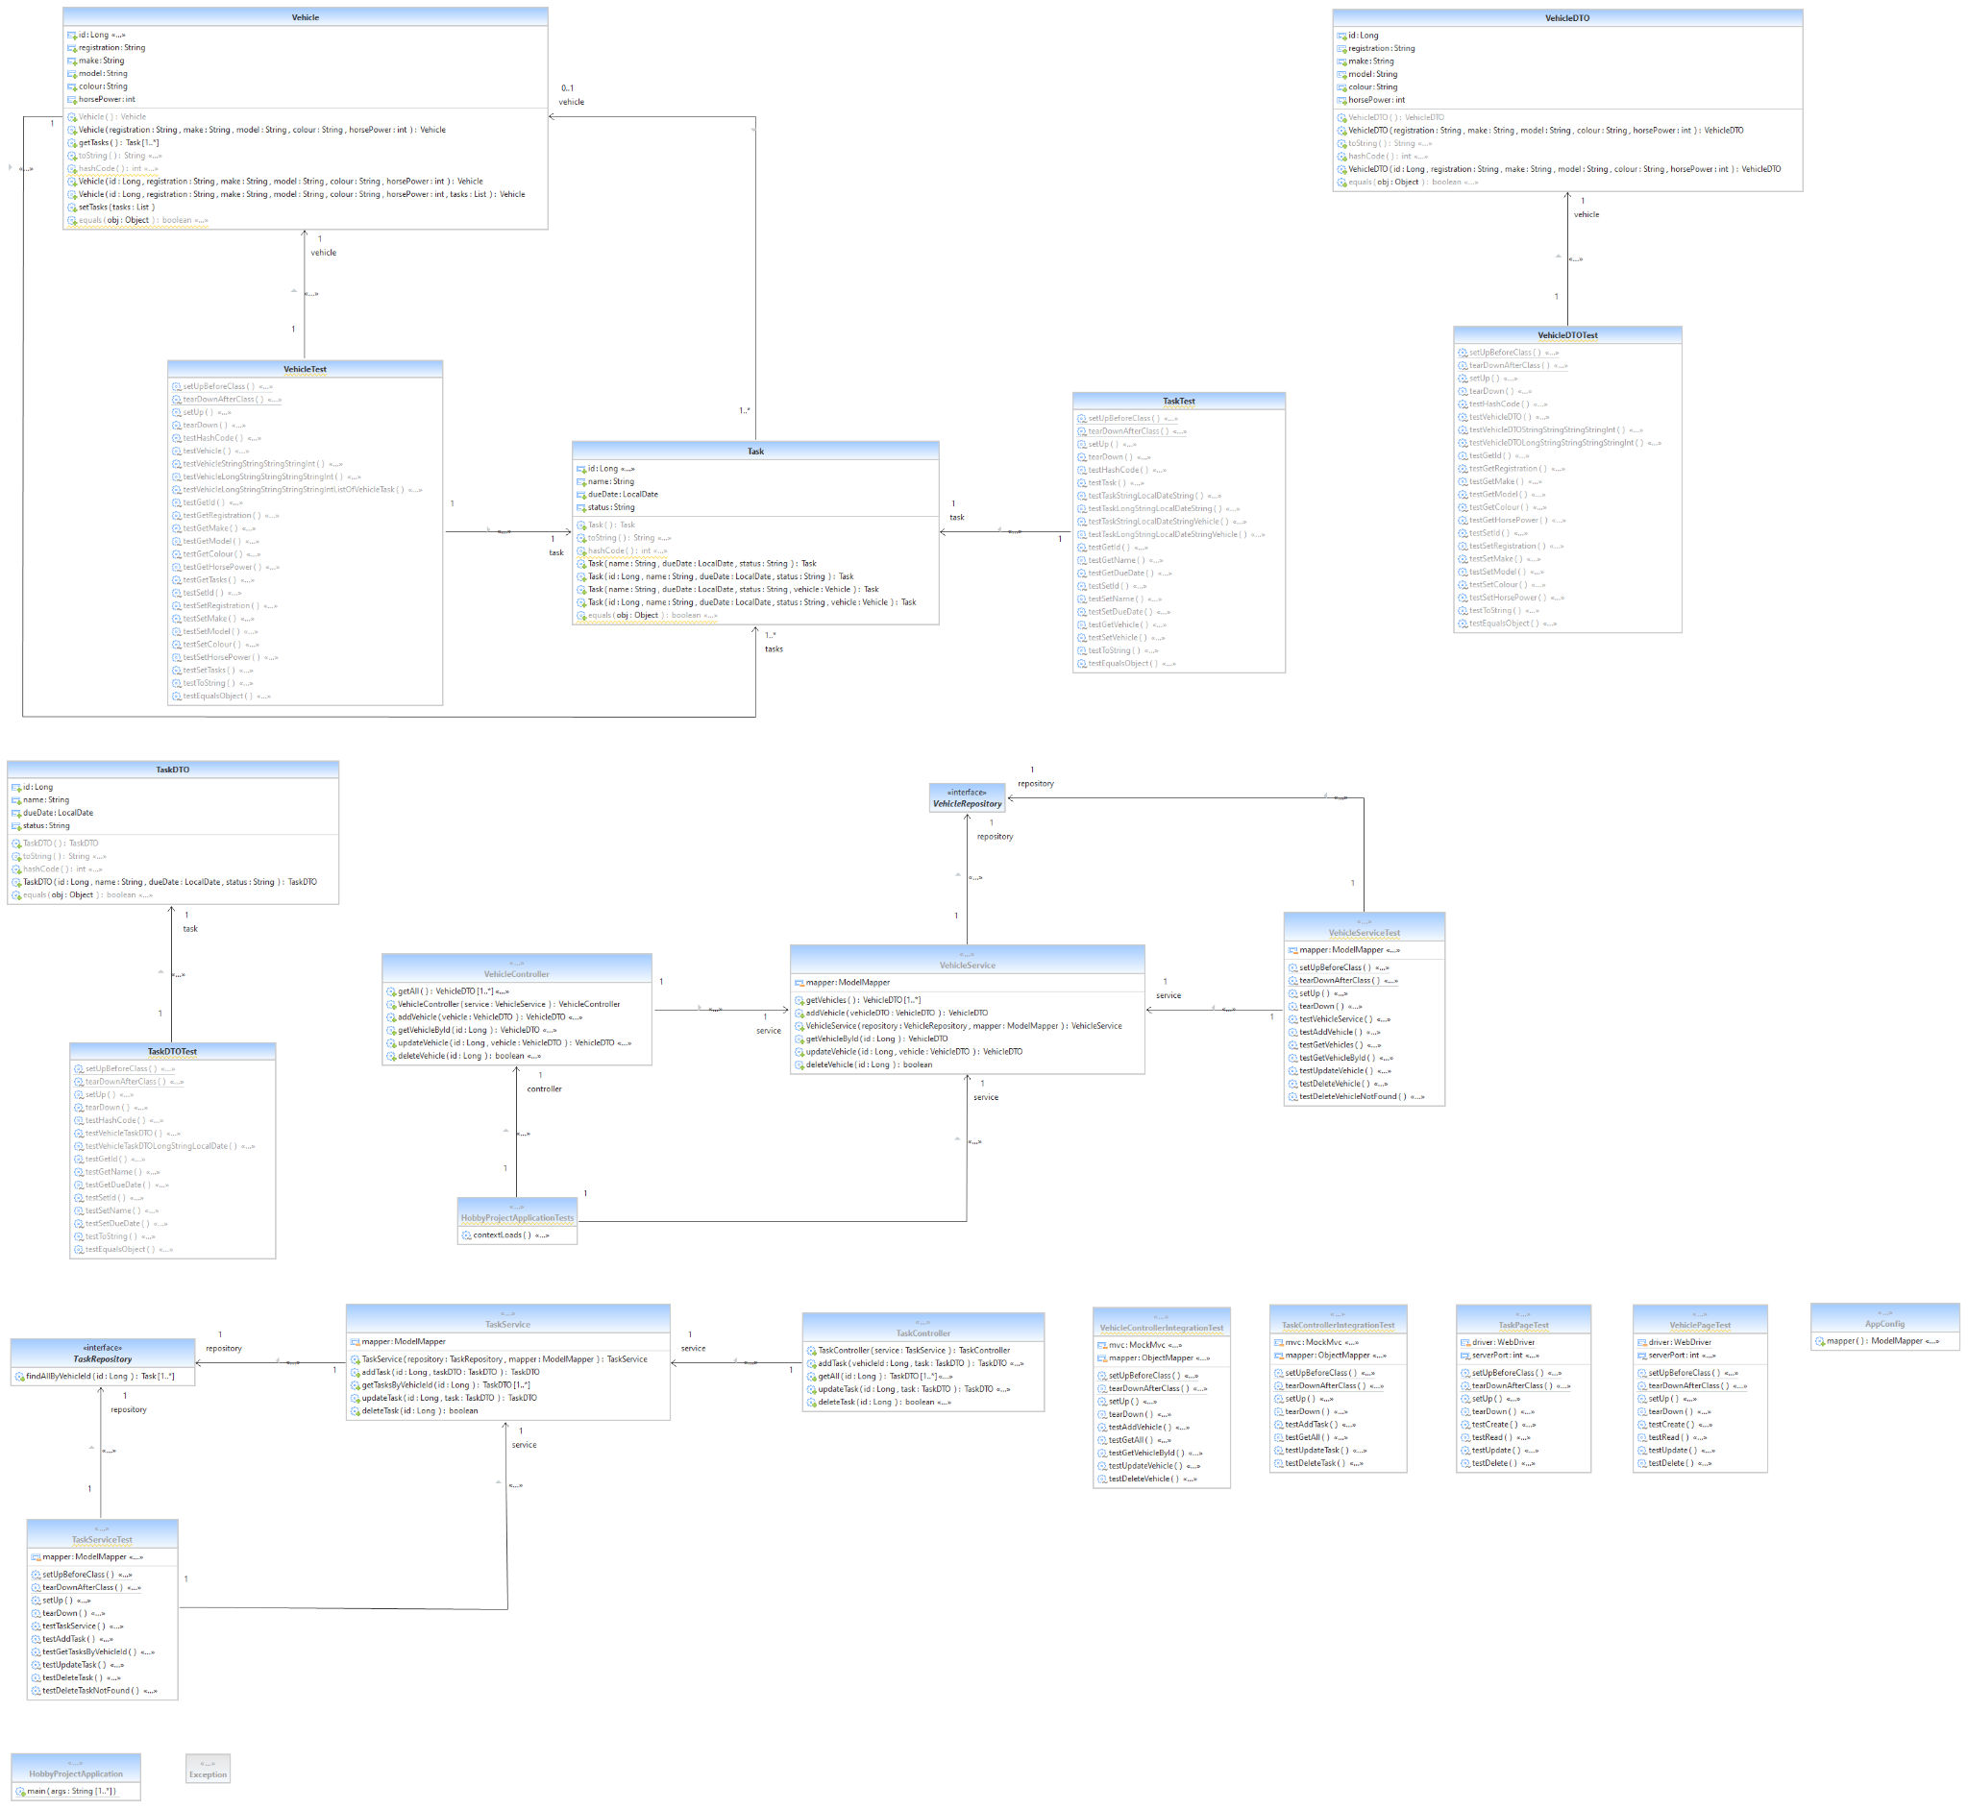
Rest API
Java
Spring Boot
framework
Postman

Slide 9
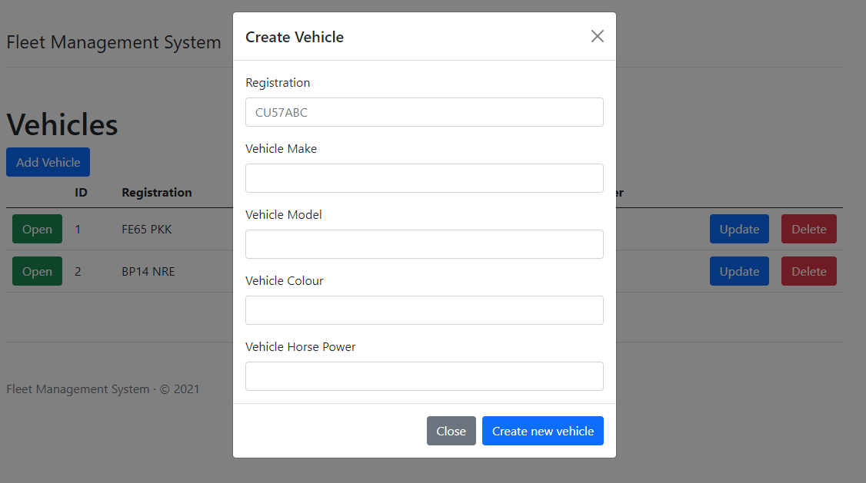
HTML / JS / CSS

Slide 10
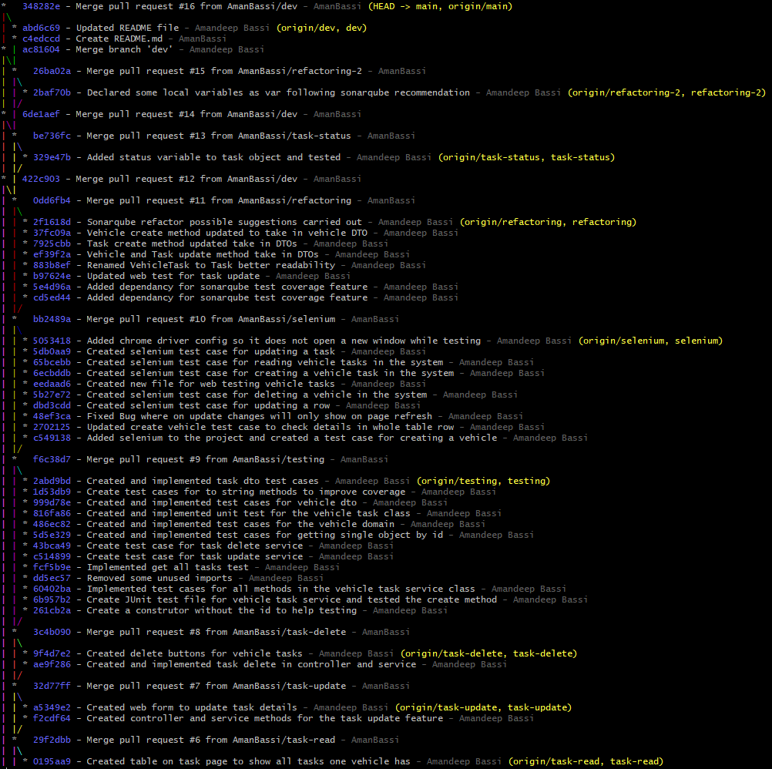
Git / GitHub

Slide 11
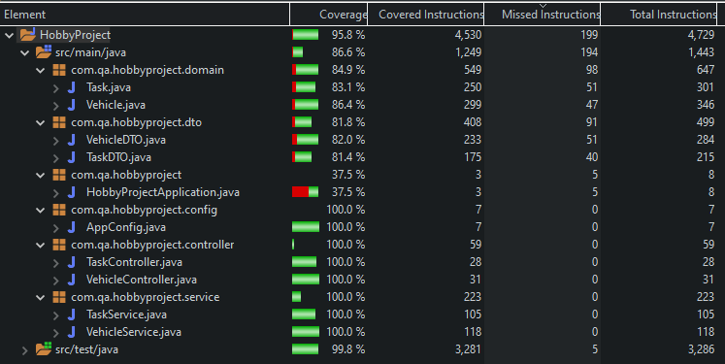
Testing

Slide 12
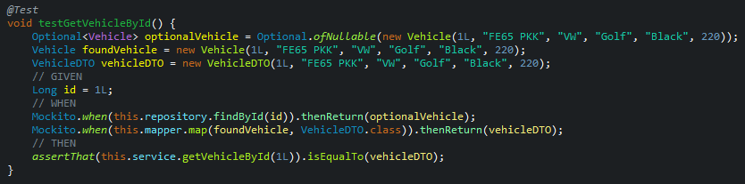
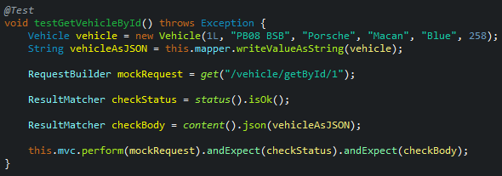
Mockito

Slide 13
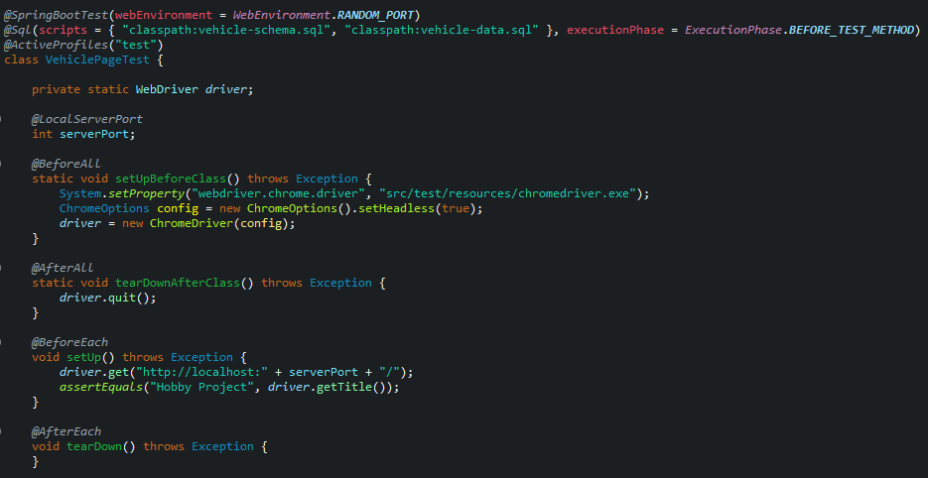
Selenium

Slide 14
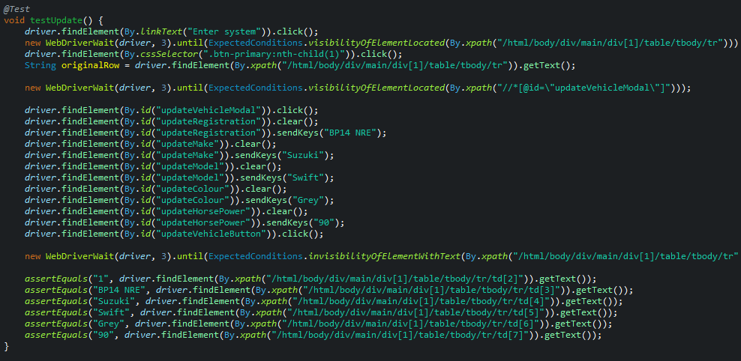
Selenium

Slide 15
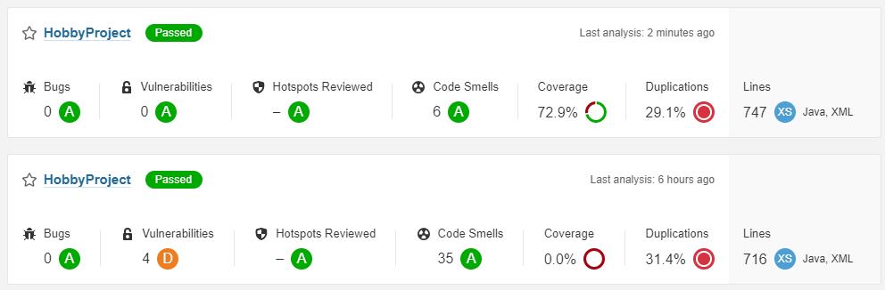
Sonarqube

Slide 16
Demonstration

Slide 17
Sprint Review

Slide 18
Sprint Retrospective
The Good
Achieved MVP
Codebase completed on time after falling behind schedule early in the project
Learned new skills (Selenium, Postman, Axios JS)
Added new status feature after I thought the project was completed
The Bad
Should have set up the project structure in a separate branch then added features
Implemented cascade delete on the Vehicle page
Used Lombok to generate code as this would have improved the Sonarqube code smells

Slide 19
Questions

